Slide 1
COVID WORLDOMETER

Slide 2
Why Covid Worldometer ?
To provide global Covid-19 statistics
Online appointment booking for Covid-19 vaccination

Slide 3
Agenda
To build a platform so that we can check country wise online covid-19 statistics. Here we have two modules i.e. user and admin.
Admin can provide and edit time slots for vaccination and view the statistics, and user can view covid-19 statistics and book appointment for vaccination.
Key Features of Admin:
Admin can register and login to the application
Update timeslots of appointment
View country wise Covid-19 statistics

Slide 4
Key Features of user:
User can login and register on the application
View global Covid-19 statistics
Book online appointment for vaccination
Choose time slot of appointment

Slide 5
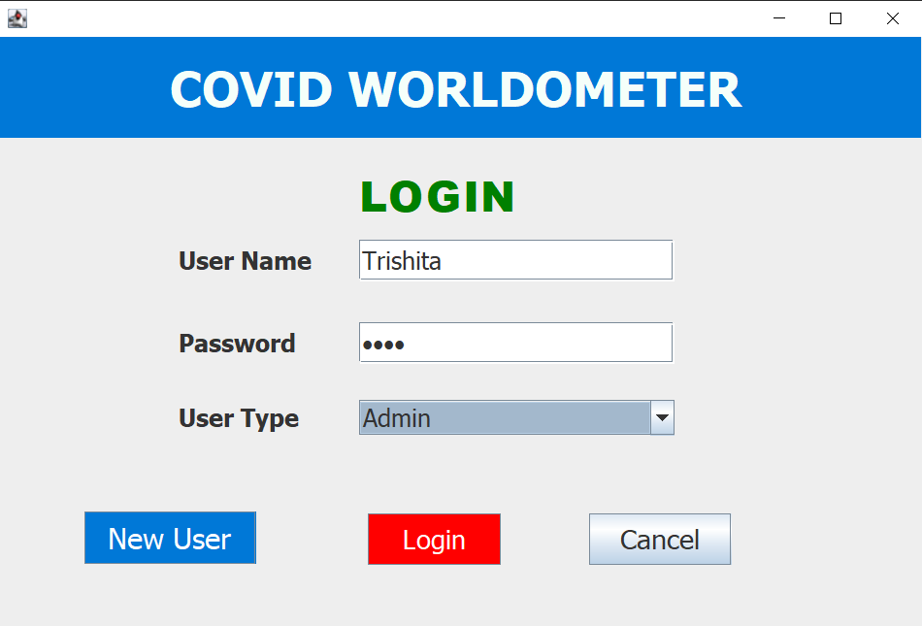
OUTCOMES
There are total 9 outcomes of this application
1. Login Page
User and Admin can Login to the application from this page by entering their user name, password and user type.

Slide 6
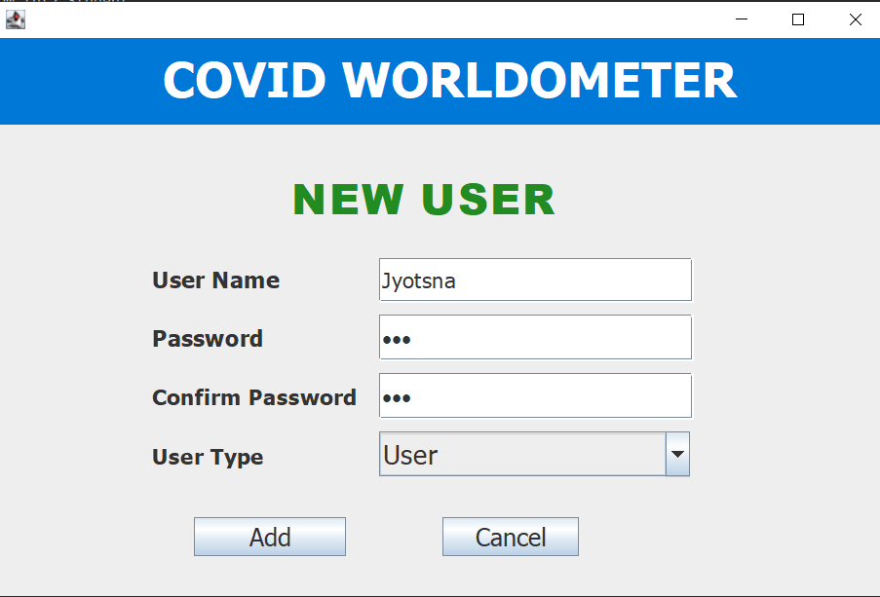
2. New User Page
If user or admin is registering in this application for the first time then they can register themselves by creating username and password

Slide 7
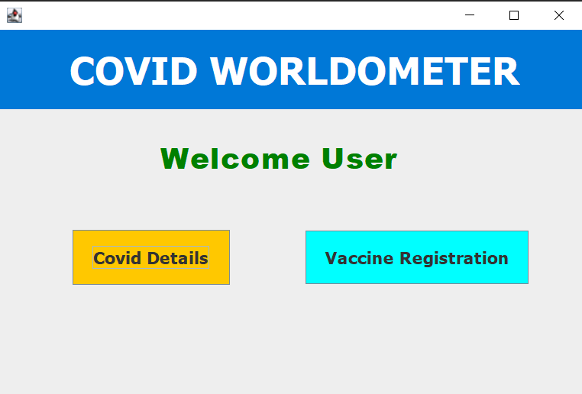
3. User Dashboard
When user login in the application then he gets 2 options- Covid details and Vaccine registrations

Slide 8
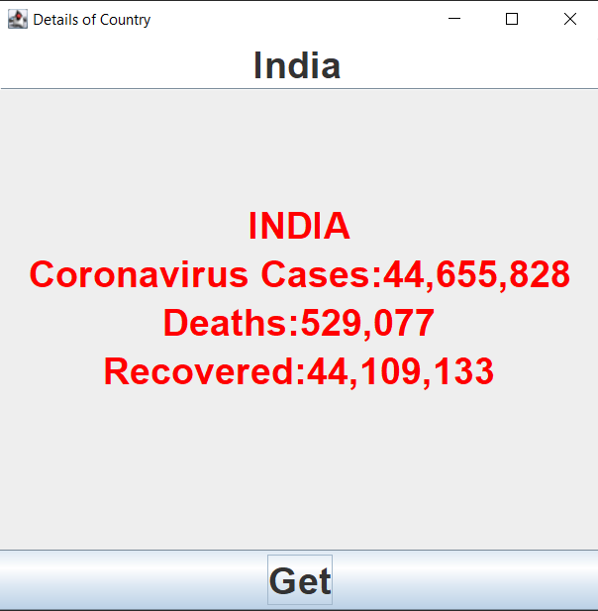
4. Covid Details
Here user and admin can see country wise covid-19 statistics

Slide 9
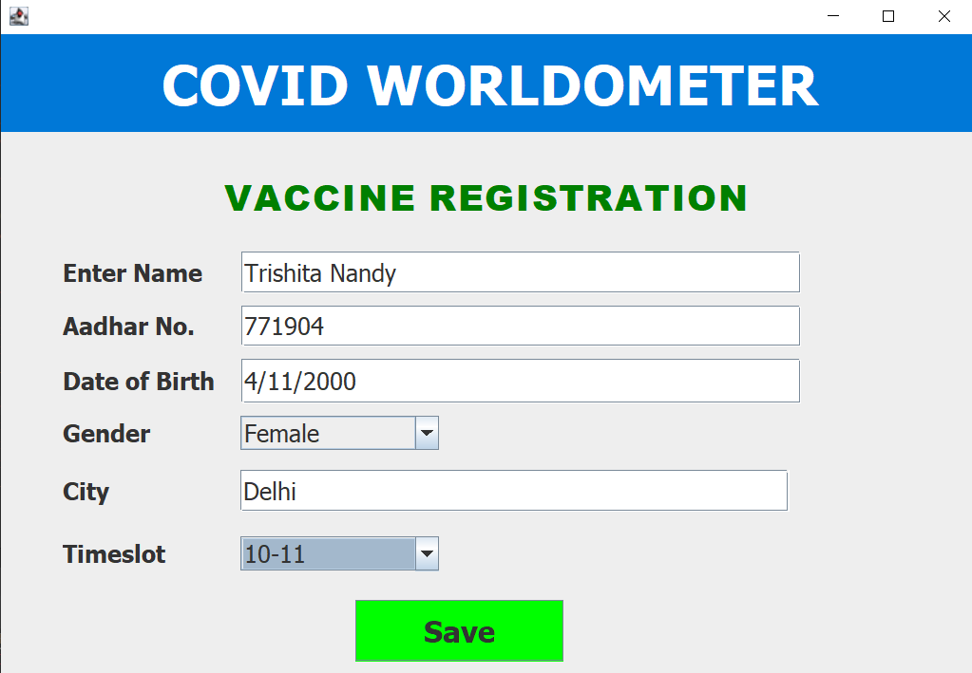
5. Vaccine Registration
User can register for online appointment for covid-19 vaccination

Slide 10
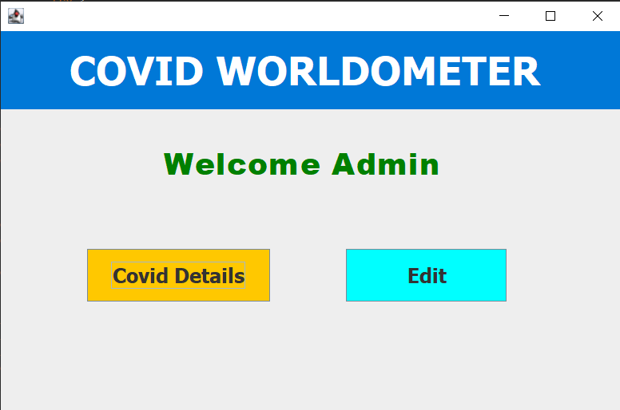
6. Admin Dashboard
Update timeslots of appointment and View country wise Covid-19 statistics

Slide 11
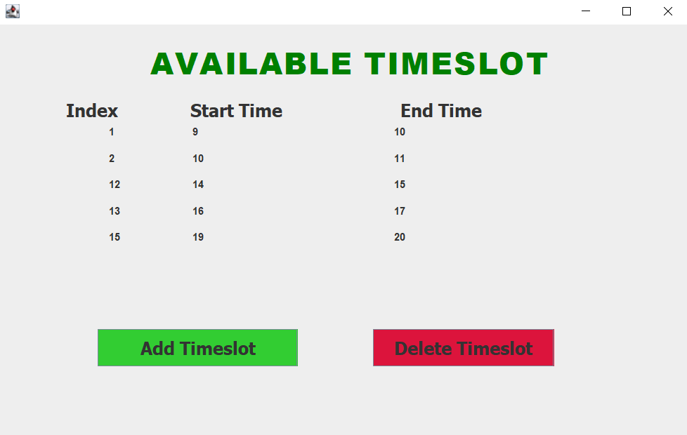
7. Available Timeslot
Here admin can see available timeslots and admin can add or delete timeslot

Slide 12
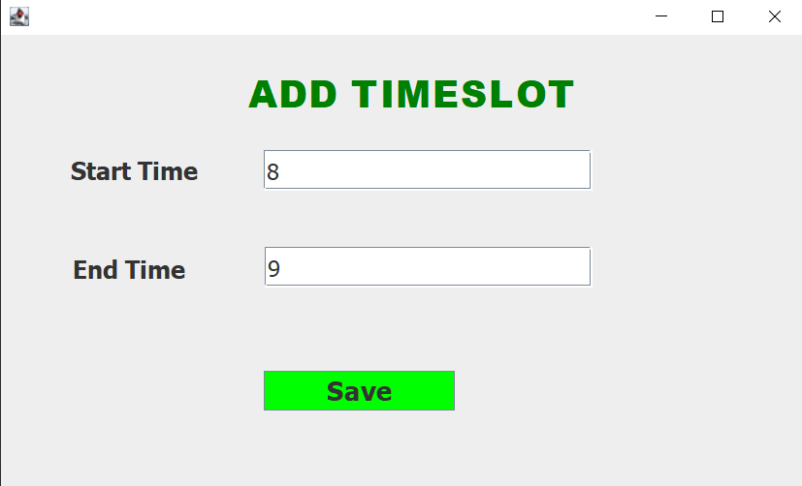
8. Add Timeslot
Admin can add new timeslots

Slide 13
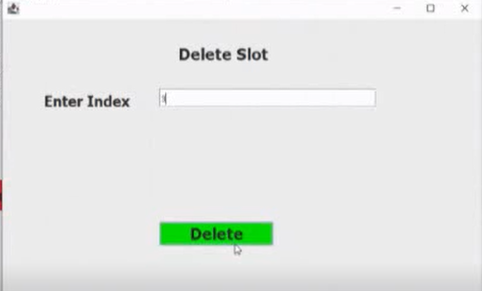
Delete Timeslot
Admin can delete any timeslot by entering its index

Slide 14
THANK YOU

